Slide 1
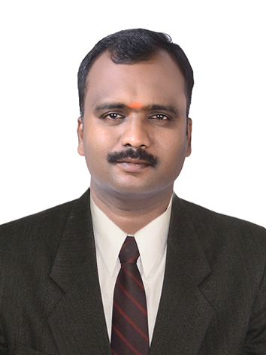
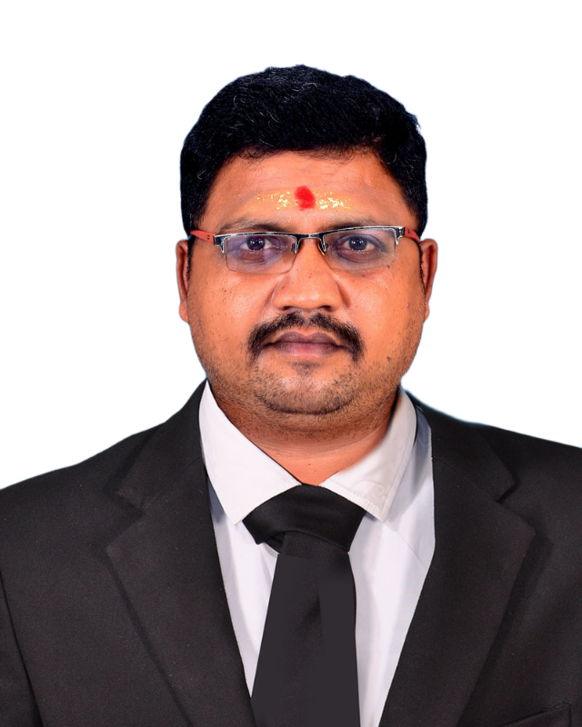
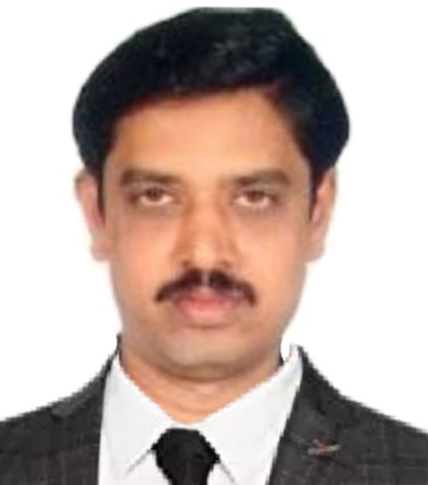
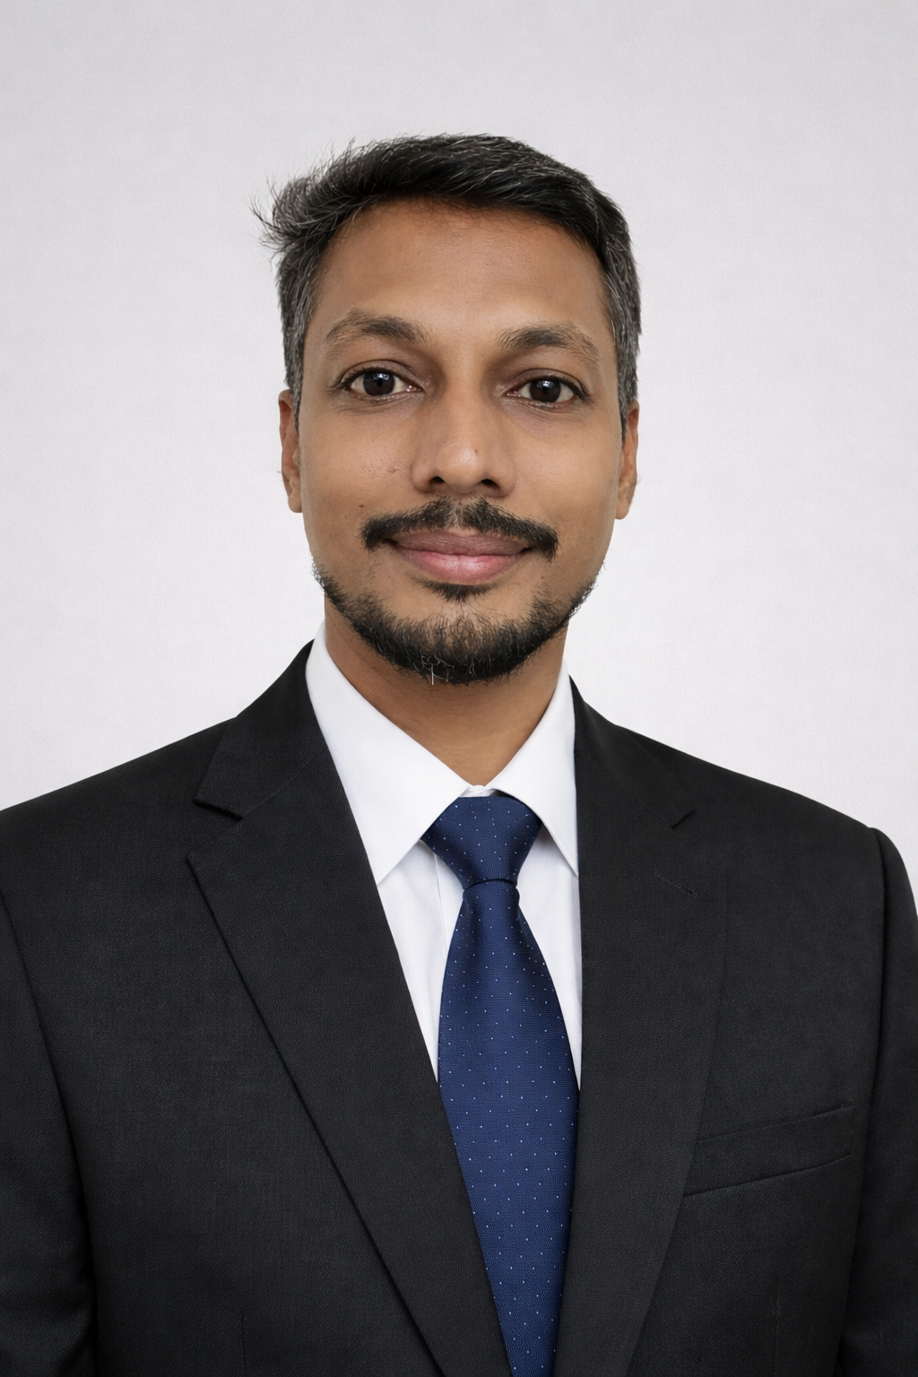
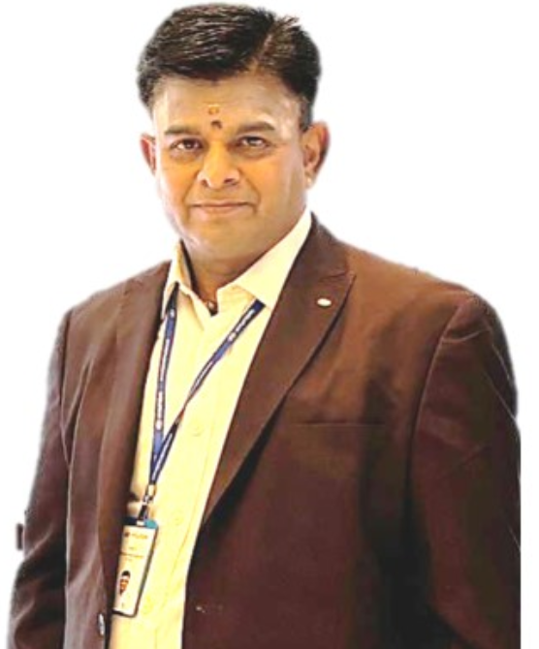
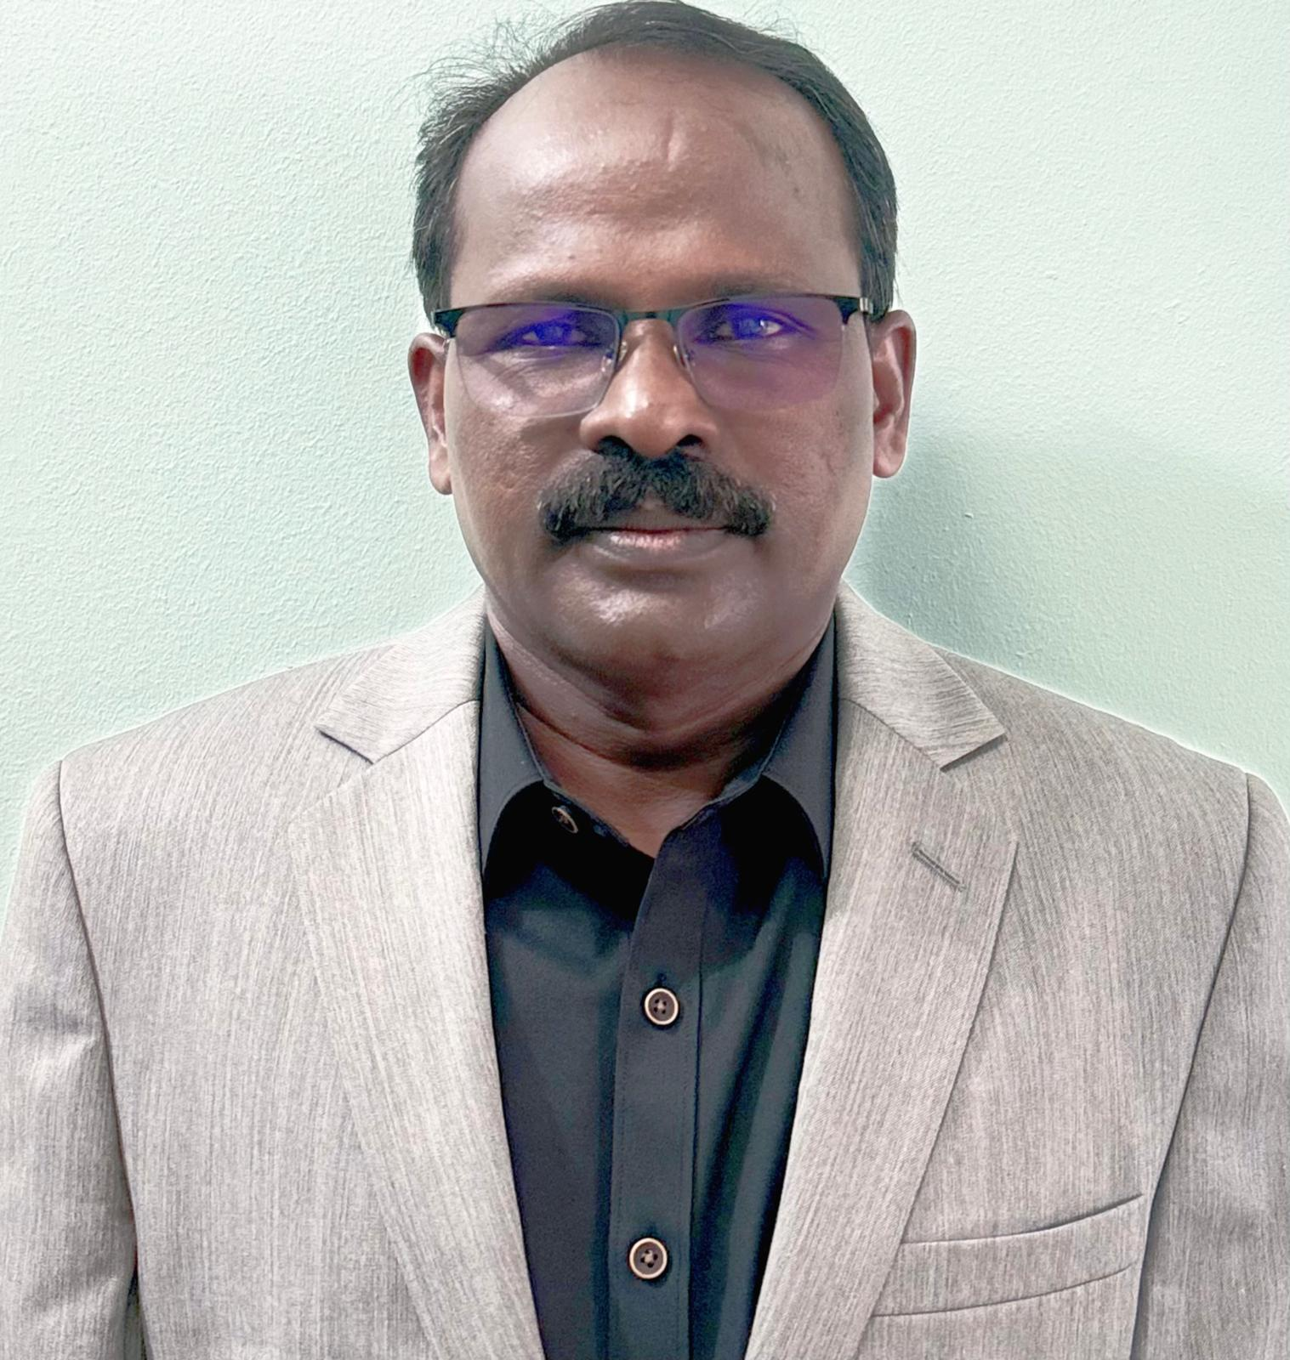
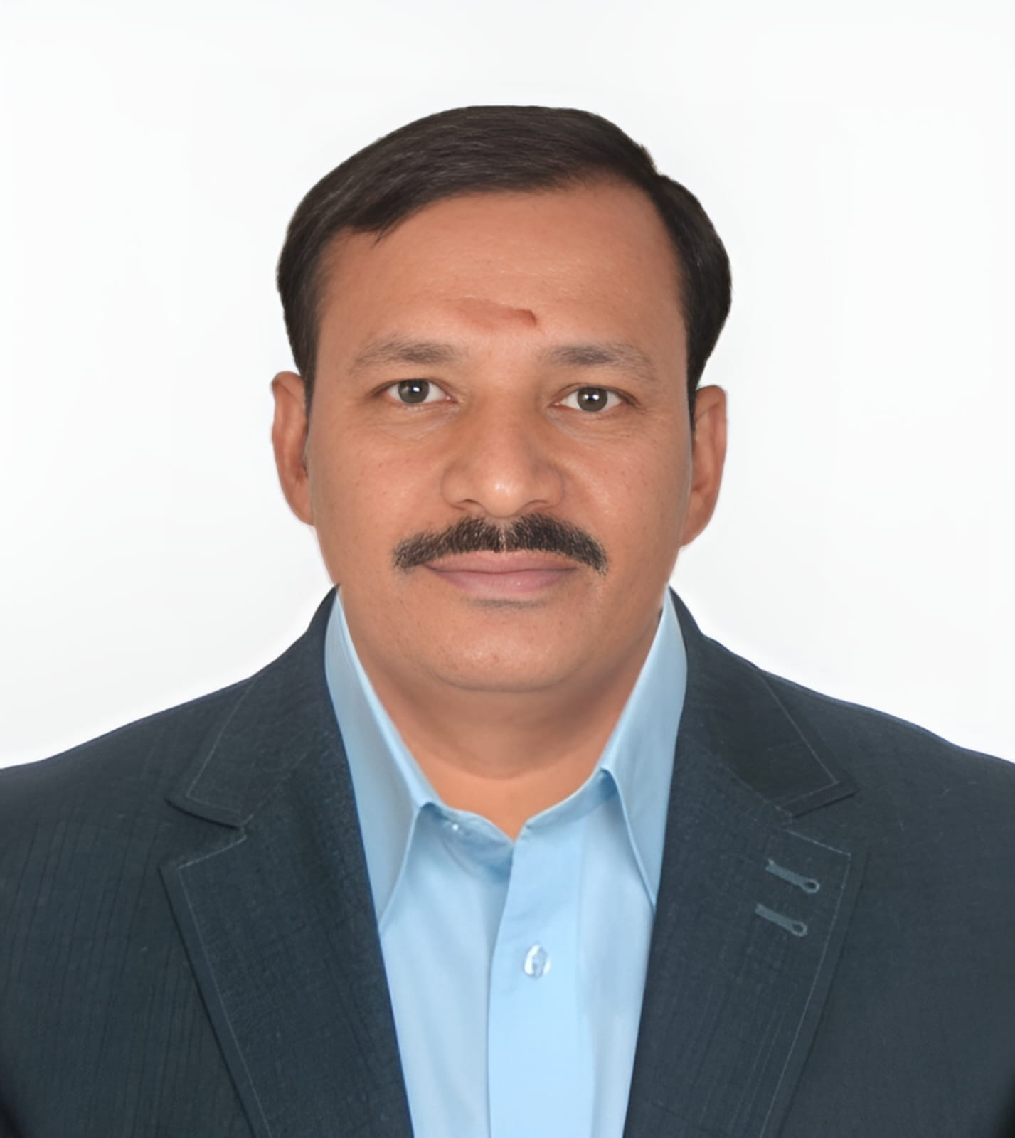
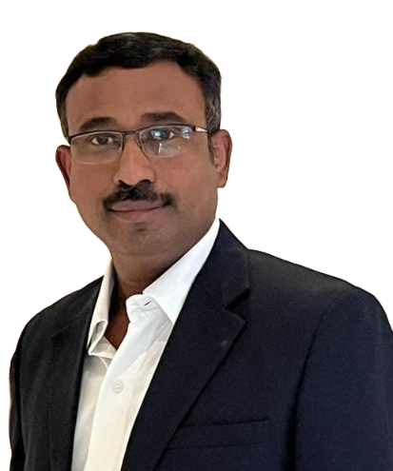
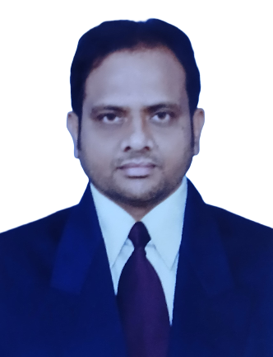
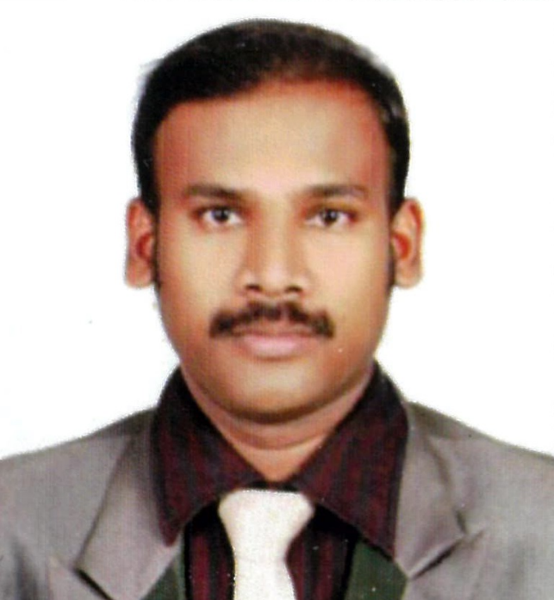
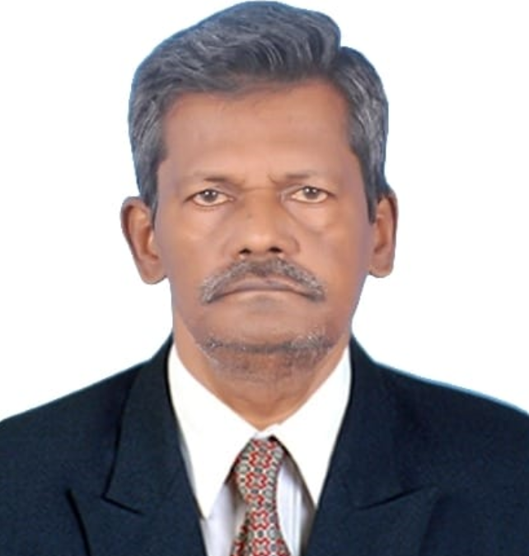
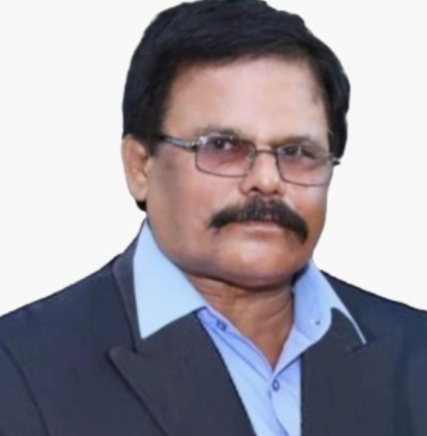
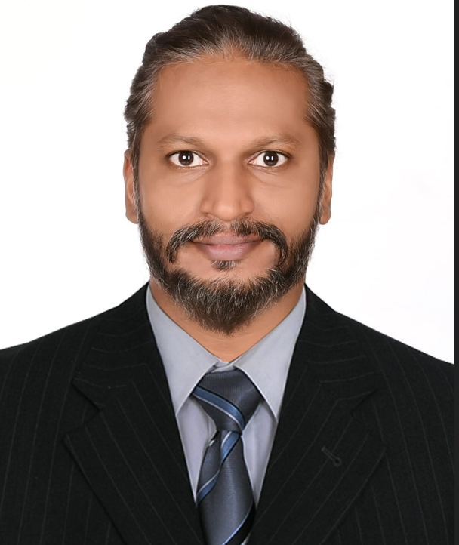
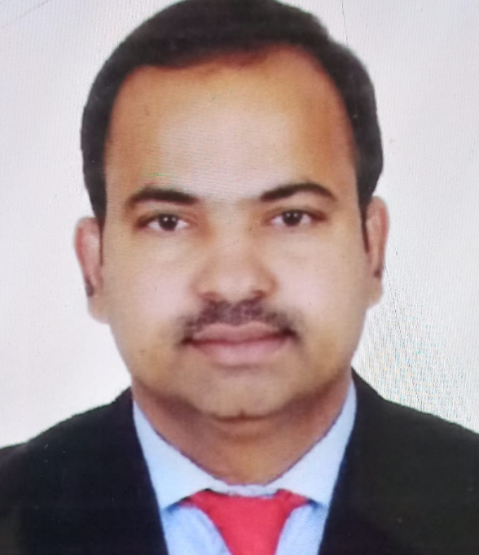
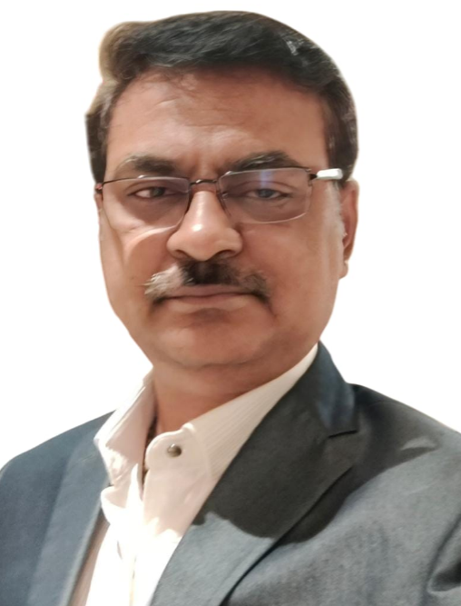
ORGANIZATION CHART - DTEAA
PRESIDENT MANIKANDAN V
JOINT.SECRETARY GOPI.A
VICE PRESIDENT VIJAY KUMAR.D
TREASURER DURAI KANNAN
G.SECRETARY KANNAN.S
REGIONAL VICE PRESIDENT’S
REGIONAL JOINT SECRETARY’S
ABROAD KUMARESAN
CHENNAI KANNAN.S
COVAI PRASATH.S
DINDIGUL PALANI.C
NORTH INDIA Suresh
ABROAD SARAVANAN
CHENNAI AYYAPPAN
COVAI DURAI RAJ
DINDIGUL SELVAKUMARAN
NORTH INDIA CHITHAMBARAM
ADVISORY BOARD
DINDIGUL TOOL ENGINEERING ALUMNI ASSOCIATION
KANAGARAJ M
SANKARLAL S

